Slide 1
Office 365 Development

Slide 2
Course Agenda
Deep Dive into the Building Blocks and Services of the SharePoint Platform
Module 1: Developing Advanced Workflow Scenarios in Office 365
Module 2: Deep Dive into SharePoint Lists for Data Storage
Module 3: Deep Dive into SharePoint Lists with REST APIs
Module 4: Deep Dive into SharePoint Lists with CSOM APIs
Module 5: SharePoint 2013 Remote Event Receivers
Module 6: Deep Dive into Search Scenarios in Office 365
Module 7: Deep Dive into Business Connectivity Services in Office 365
Module 8: Developing Advanced Taxonomy Scenarios in Office 365

Slide 3
Deep Dive into Search Scenarios in Office 365
Speaker
Speaker

Slide 4

Agenda
Overview
Search Building Blocks
Extending Search Center
Search-Based Apps

Slide 5
Overview

Slide 6















Vision
EXTEND OFFICE EVERYWHERE
CONNECT TO OFFICE 365 SERVICES
BUILD USING AN OPEN PLATFORM
Delve
z
Users and groups
Files
Mail
Calendar
My Apps
Video Portal
Contacts
Office Graph
Presentations
Documents
Spreadsheets
Lync
OneNote
Yammer

Slide 7

SharePoint App Building Blocks
SharePoint Apps
aspx
Databases
png
master
CSS
js
Web Services
SharePoint
REST
CSOM
SharePoint API
Managed
Metadata
Search
Service
Workflow
Service
BCS
List and Libraries
Service Applications

Slide 8
Search Service Value
Single service application for locating documents, people, and data within SharePoint
Extend the OOB Search Center to create unique solutions with customized results, displays, and functionality
Use the Search API to incorporate search functionality in SharePoint apps

Slide 9
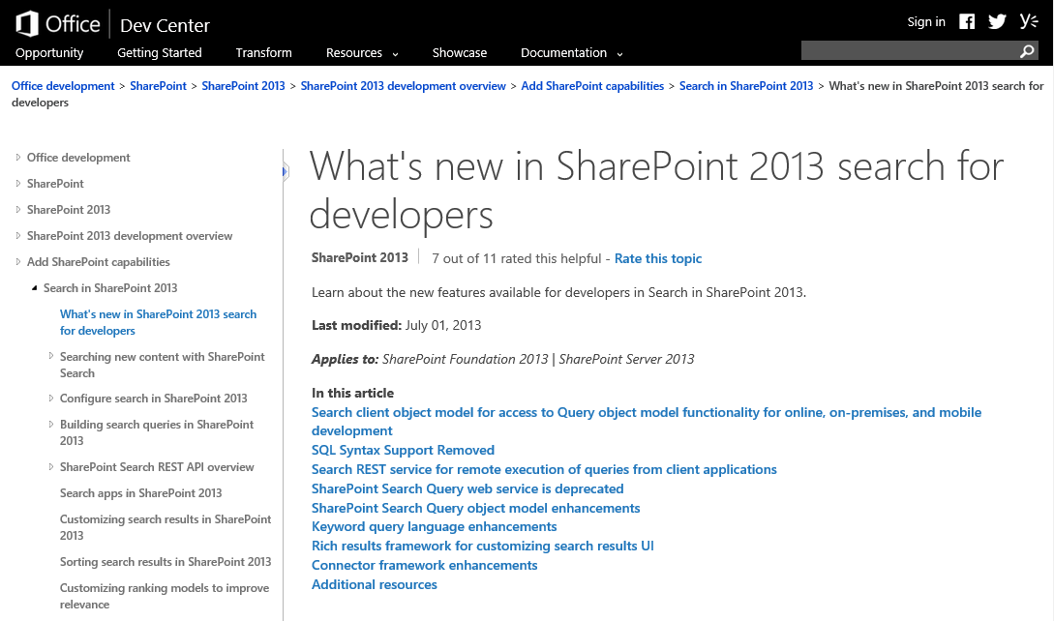
Office Dev Center

Slide 10
Search Building Blocks

Slide 11
Building Blocks
Managed Properties
Result Sources
Query Rules
Result Types
Search Navigation

Slide 12
Managed Properties
Mapped to Crawled Properties
Tenancy level
Site Collection level
Site Columns Become Managed Properties
Publishing and Multiple Lines prefixed with ows_r_<four-letter-code>
Managed Metadata prefixed with ows_taxId
All others prefixed with ows_q_<four-letter-code>

Slide 13
Managed Properties
Property | Description
Queryable | Managed Property can be used in property-based searches
Refinable | Managed Property can be used as a refiner
Retrievable | Managed Property can be returned in the results
Searchable | Includes the value of the Managed Property in the Search Index
Sortable | Managed Property can be used for sorting results
Type | The data type of the Managed Property
Safe | Can be returned to anonymous users
Alias | Friendly names
Multi-valued | Managed Property can have multiple values
Notes:
Tenant
SSA
Site Collection level

Slide 14
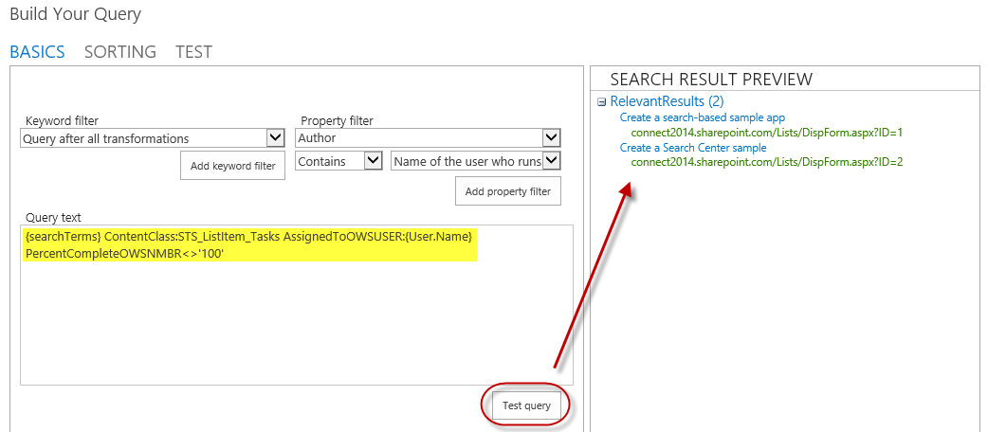
Result Sources
Select a Source
Local SharePoint Index
Remote SharePoint Index
OpenSearch
Exchange
Apply a Query Transformation
Defines a subset of the source

Slide 15
Query Rules
Applied to a given Result Source
Processed under specified conditions
Keyword match
Topic category match
Affects the query results
Alter the user’s query
Generate a Result Block

Slide 16
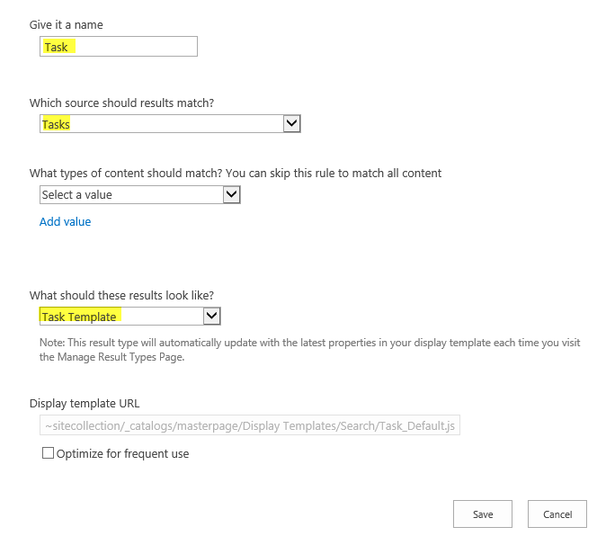
Result Types
Bound to a given Result Source
Defined by a rule
Associated with a template for display
Determines how Result Type appears
Created as an HTML file referencing Managed Properties

Slide 17
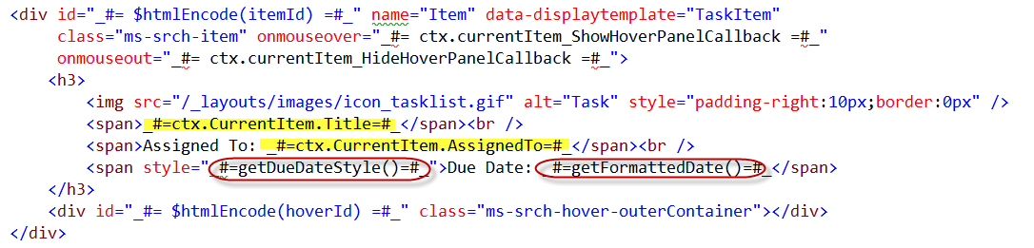
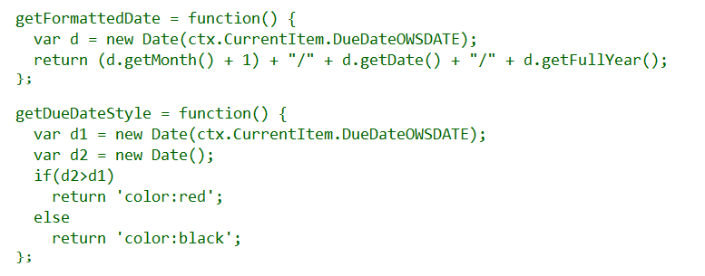
Display Templates

Slide 18
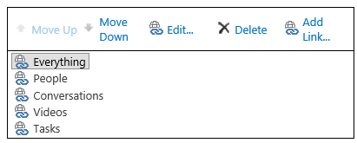
Search Navigation
Provides navigation across pages in Search Center

Slide 19
Export/Import Search Settings
Configuration export
SearchConfiguration.xml
Handles rules, sources, managed properties, etc.
Does not handle master pages, templates, and web parts
Configuration import
Import into site, site collection, tenancy
Programmatically import with app

Slide 20
Extending Search Center

Slide 21
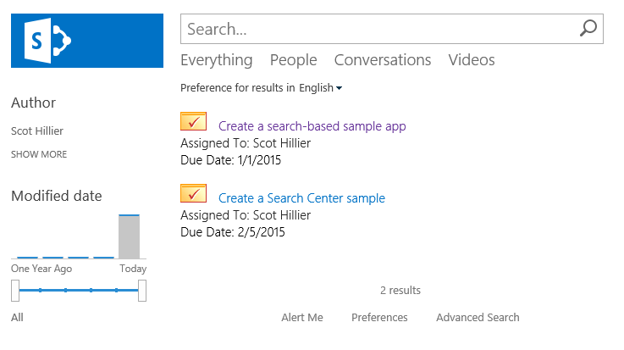
Custom Search Results
Use building blocks to create custom solutions in Search Center

Slide 22
Automating Search Center Modifications
Use App Installed Event to trigger modifications
Activating features
Uploading display templates
Manipulating web part properties
Include exported search configurations in apps
Add new “Search Configuration” to app

Slide 23
Activating Features
//Enable Publishing Infrastructure Feature
Guid id = new Guid("{F6924D36-2FA8-4f0b-B16D-06B7250180FA}");
var query1 = from f in clientContext.Site.Features
where f.DefinitionId == id
select f;
var features = clientContext.LoadQuery(query1);
clientContext.ExecuteQuery();
if (features.Count() == 0) {
clientContext.Site.Features.Add(id, false, FeatureDefinitionScope.None);
clientContext.ExecuteQuery();
}

Slide 24
Uploading Display Template
//Upload Display template
List gallery = clientContext.Site.RootWeb.Lists.GetByTitle(
MASTER_PAGE_GALLERY_TITLE);
Folder folder = clientContext.Site.RootWeb.GetFolderByServerRelativeUrl(
DISPLAY_TEMPLATE_FOLDER_URL);
clientContext.ExecuteQuery();
System.IO.FileStream fs = System.IO.File.Open(
HostingEnvironment.MapPath(DISPLAY_TEMPLATE_PATH),
System.IO.FileMode.Open, System.IO.FileAccess.Read);
FileCreationInformation fileCreationInfo = new FileCreationInformation();
fileCreationInfo.ContentStream = fs;
fileCreationInfo.Url = DISPLAY_TEMPLATE_NAME;
fileCreationInfo.Overwrite = true;
Microsoft.SharePoint.Client.File newFile = folder.Files.Add(fileCreationInfo);
clientContext.Load(newFile);
clientContext.ExecuteQuery();

Slide 25
Manipulating Web Parts
File resultsPage = webs.First().GetFileByServerRelativeUrl(SEARCH_PAGE_URL);
resultsPage.CheckOut(); clientContext.ExecuteQuery();
LimitedWebPartManager manager =
resultsPage.GetLimitedWebPartManager(PersonalizationScope.Shared);
var webPartDefs = manager.WebParts;
clientContext.Load(
webPartDefs,
parts => parts.Include(part => part.WebPart.Properties),
parts => parts.Include(part => part.WebPart.Title));
clientContext.ExecuteQuery();

Slide 26
Search Configuration
<SearchConfigurationSettings
xmlns:i="http://www.w3.org/2001/XMLSchema-instance"
xmlns="http://schemas.datacontract.org/2004/07/Microsoft.Office.Server.Search.Portability">
<SearchQueryConfigurationSettings>
<SearchQueryConfigurationSettings>
<BestBets xmlns:d4p1="http://www.microsoft.com/sharepoint/search/KnownTypes/2008/08" />
<DefaultSourceId>00000000-0000-0000-0000-000000000000</DefaultSourceId>
<DefaultSourceIdSet>true</DefaultSourceIdSet>
<DeployToParent>true</DeployToParent>
<DisableInheritanceOnImport>false</DisableInheritanceOnImport>
<QueryRuleGroups xmlns:d4p1="http://www.microsoft.com/sharepoint/search/..." />
<QueryRules xmlns:d4p1="http://www.microsoft.com/sharepoint/search/..." />
<ResultTypes xmlns:d4p1="http://schemas.datacontract.org/2004/07/...">
...

Slide 27
demo
Extending Search Center

Slide 28
Search-Based Apps

Slide 29
REST Endpoint
Keywords
https://tenant/site/_api/search/query?querytext='{KQL Query}'
Selecting Properties
https://tenant/site/_api/search/query?querytext='test'&selectproperties='Title,Rank'
Sorting
https://tenant/site/_api/search/query?querytext='test'&sortlist='LastModifiedTime:descending'

Slide 30
JavaScript and REST
$.ajax(
{
url: "http://site/_api/search/" +
"query?querytext='{KQL Query}‘",
method: "GET",
headers: {
"accept": "application/json;odata=verbose",
},
success: onSuccess,
error: onError
}
);

Slide 31
JavaScript and CSOM
var context = SP.ClientContext.get_current();
var keywordQuery =
new Microsoft.SharePoint.Client.Search.Query.KeywordQuery(context);
keywordQuery.set_queryText("sharepoint");
var searchExecutor =
new Microsoft.SharePoint.Client.Search.Query.SearchExecutor(context);
results = searchExecutor.executeQuery(keywordQuery);
context.executeQueryAsync(onGetEventsSuccess, onGetEventsFail);

Slide 32
C# and REST
var spContext = SharePointContextProvider.Current.GetSharePointContext(HttpContext);
string accessToken = spContext.UserAccessTokenForSPAppWeb;
string url = "http://site/_api/search/query?querytext='sharepoint'";
HttpClient client = new HttpClient();
HttpRequestMessage request = new HttpRequestMessage(HttpMethod.Get, url);
request.Headers.Accept.Add(new MediaTypeWithQualityHeaderValue("application/xml"));
request.Headers.Authorization = new AuthenticationHeaderValue("Bearer", accessToken);
HttpResponseMessage response = await client.SendAsync(request);
string responseString = await response.Content.ReadAsStringAsync();

Slide 33
C# and CSOM
var spContext = SharePointContextProvider.Current.GetSharePointContext(Context);
using (var cctx = spContext.CreateUserClientContextForSPHost())
{
KeywordQuery query = new KeywordQuery(cctx);
query.QueryText = "{KQL}";
SearchExecutor executor = new SearchExecutor(cctx);
ClientResult<ResultTableCollection> results = executor.ExecuteQuery(query);
cctx.ExecuteQuery();
}

Slide 34
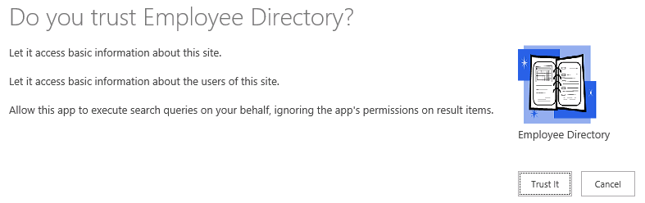
App Permissions
<AppPermissionRequest Scope=http://sharepoint/search
Right="QueryAsUserIgnoreAppPrincipal" />

Slide 35
demo
Search-Based Apps

Slide 36
Summary
Overview
Search Building Blocks
Extending Search Center
Search-Based Apps

Slide 37



dev.office.com
Sign up
http://dev.office.com/getting-started
Explore
http://apisandbox.msdn.microsoft.com
Get trained http://dev.office.com/training

Slide 38


Feedback
Office 365 Network Share you best practices and join conversations https://www.yammer.com/itpronetwork
Stackoverflow Ask deep technical questions to a world-wide set of developers
http://stackoverflow.com/questions/tagged/ms-office
UserVoice Provide suggestions of what you want in future versions
http://officespdev.uservoice.com/

